Slide 1
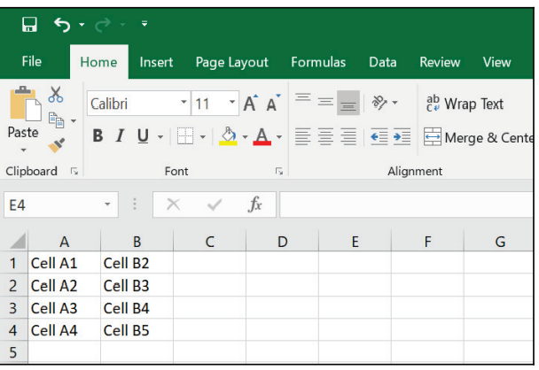
File operation with step-by-step example on excel
Read cell
Write cell
Read range
Write range
Append range

Slide 2
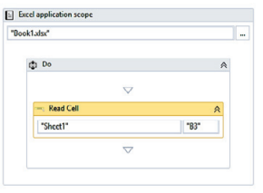
Excel – Read Cell
Read the value of a cell from an Excel file
we have to read the value of the B3 cell:
Drag and drop a Flowchart activity and drag and drop an Excel application scope
Drag and drop the Read Cell activity – The Result output Create a variable of type string
3. Drag and drop a Message box and add result output variable in it.
Run

Slide 3
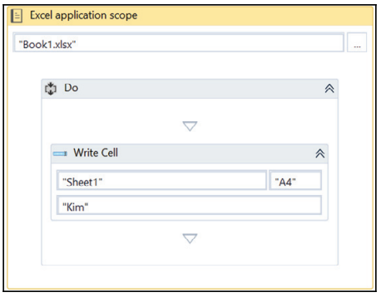
Excel – Write Cell
Read the value of a cell from an Excel file
we have to read the value of the A4 cell:
Drag and drop a Flowchart activity and drag and drop an Excel application scope
Drag and drop the Write Cell activity –Specify the cell name”A4” in the Write Celll and give the value required
Run

Slide 4
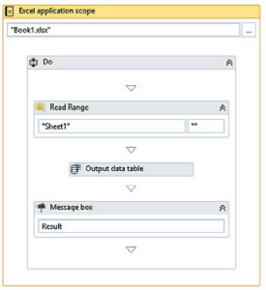
Excel: Read Range No Range Parameter acts as Simple Read
Drag and drop a Flowchart activity and drag and drop an Excel application scope
In Excel application scope Drag and drop the Read Range activity – The Output property Create a variable of type data table
In Excel application scope Drag and drop an Output Data Table activity
Specify Data Table property
Specify Output Data Table property
Drag and drop a Message box activity inside the Excel application scope activity.

Slide 5
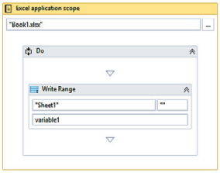
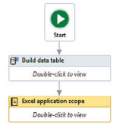
Excel Write range
1. Drag and drop a Build data table activity from the Activities panel. Change column and rows according to requirement
2. create table accordingly like Roll No. Name and data of atleast 3 and specify the variable name of type data table
3. Drag and drop excel application scope and connect this with build data table in step 2
4. Specify data table variable name and set it as data table property inside write range

Slide 6
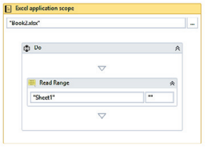
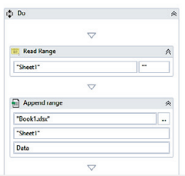
Append Range
1. Drag and drop the Flowchart activity and drag and drop the Excel application scope
The Append Range activity requires a data table
2. Drag and drop the Read Range activity inside the Excel application scope activity. Create a data table variable
3. Drag and drop the Append Range activity inside the Excel application scope activity. Specify the Excel file path in the Append Range activity

Slide 7
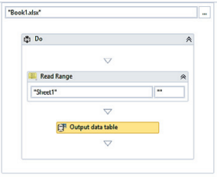
CSV/Excel to data table
Drag and drop the Flowchart activity and Drag and drop the Excel Application scope inside the flowchart
Drag and drop the Read Range activity from the Activities panel inside the Excel application scope. Create a variable of type data table and specify it in the Output property

Slide 8
CSV/Excel to data table
Drag and drop the Output Data Table activity inside the Excel application scope activity.
the Data Table property
The Data Table property of the Output Data Table activity is used to convert the Data Table into string format.
the text property
The text property is used to supply its value in a string format.
Drag and drop a Message box activity inside the Excel application scope activity.

Slide 9
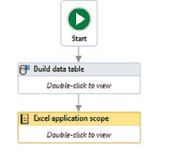
Creating a data table and then writing all its data to an Excel file
Drag and drop a Build data table activity from the Activities panel. Make table accordingly
Create a variable of type Data Table. Give it a meaningful name. Specify this data table's name in the Data Table property of the Build data table activity
Drag and drop the Excel application scope inside the main Designer window. Specify the Excel sheet's path or manually select it.
Connect this activity to the Build Data table activity

Slide 10
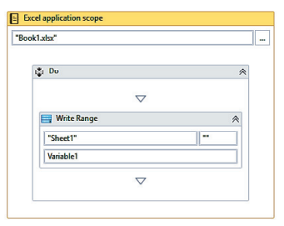
Creating a data table and then writing all its data to an Excel file
Inside the Excel application scope activity, drag and drop the Write Range activity. Specify the data table variable name
That's it. Hit the Run button

